Slide 1

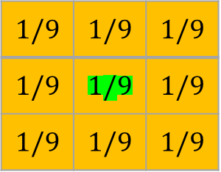
 | 0 | 1 | 2 | 3 | 4 | 5 | 6 | 7 | 8
0 | 2 | 50 | 10 | 100 | 50 | 45 | 12 | 33 | 11
1 | 20 | 10 | 50 | 155 | 150 | 160 | 80 | 60 | 10
2 | 80 | 25 | 87 | 200 | 245 | 255 | 80 | 80 | 30
3 | 2 | 255 | 10 | 100 | 50 | 45 | 12 | 33 | 11
4 | 25 | 10 | 20 | 155 | 150 | 160 | 80 | 60 | 10
5 | 80 | 42 | 80 | 200 | 245 | 255 | 80 | 80 | 30
6 | 50 | 50 | 50 | 10 | 10 | 240 | 245 | 244 | 244
7 | 20 | 60 | 20 | 155 | 150 | 160 | 80 | 60 | 10
8 | 20 | 60 | 20 | 155 | 150 | 160 | 80 | 60 | 10
Original Image
$$1/9$$ | $$1/9$$ | $$1/9$$
$$1/9$$ | $$1/9$$ | $$1/9$$
$$1/9$$ | $$1/9$$ | $$1/9$$
$$filterSize=2k+1$$

Slide 2
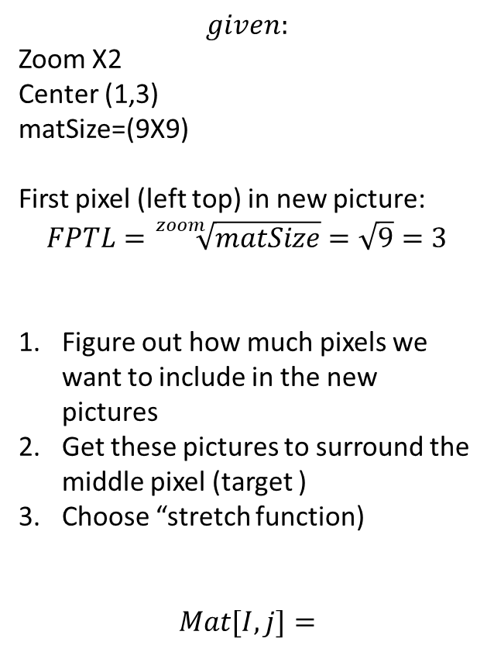
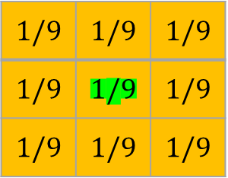
 | 0 | 1 | 2 | 3 | 4 | 5 | 6 | 7 | 8
0 | (0,0) | (1,0) | (2,0) | (3,0) | (4,0) | (5,0) | (6,0) | (7,0) | (8,0)
1 | (0,1) | (1,1) | (2,1) | (3,1) | (4,1) | (5,1) | (6,1) | (7,1) | (8,1)
2 | (0,2) | (1,2) | (2,2) | (3,2) | (4,2) | (5,2) | (6,2) | (7,2) | (8,2)
3 | (0,3) | (1,3) | (2,3) | (3,3) | (4,3) | (5,3) | (2,3) | (2,3) | (2,3)
4 | (0,3) | (0,3) | (0,3) | (1,3) | (1,3) | (1,3) | (2,3) | (2,3) | (2,3)
5 | (0,3) | (0,3) | (0,3) | (1,3) | (1,3) | (1,3) | (2,3) | (2,3) | (2,3)
6 | (0,4) | (0,4) | (0,4) | (1,4) | (1,4) | (1,4) | (2,4) | (2,4) | (2,4)
7 | (0,4) | (0,4) | (0,4) | (1,4) | (1,4) | (1,4) | (2,4) | (2,4) | (2,4)
8 | (0,4) | (0,4) | (0,4) | (1,4) | (1,4) | (1,4) | (2,4) | (2,4) | (2,4)
Mesh Grid - TARGET
$$given:$$
Zoom X2
Center (1,3)
matSize=(9X9)
First pixel (left top) in new picture:
$$FPTL=\sqrt[zoom]{matSize}=\sqrt{9}=3$$
Figure out how much pixels we want to include in the new pictures
Get these pictures to surround the middle pixel (target )
Choose “stretch function)
$$Mat[I,j]=$$
$$1/9$$ | $$1/9$$ | $$1/9$$
$$1/9$$ | $$1/9$$ | $$1/9$$
$$1/9$$ | $$1/9$$ | $$1/9$$

Slide 3
 | 0 | 1 | 2 | 3 | 4 | 5 | 6 | 7 | 8
0 | (0,2) | (0,2) | (0,2) | (1,2) | (1,2) | (1,2) | (2,2) | (2,2) | (2,2)
1 | (0,2) | (0,2) | (0,2) | (1,2) | (1,2) | (1,2) | (2,2) | (2,2) | (2,2)
2 | (0,2) | (0,2) | (0,2) | (1,2) | (1,2) | (1,2) | (2,2) | (2,2) | (2,2)
3 | (0,3) | (0,3) | (0,3) | (1,3) | (1,3) | (1,3) | (2,3) | (2,3) | (2,3)
4 | (0,3) | (0,3) | (0,3) | (1,3) | (1,3) | (1,3) | (2,3) | (2,3) | (2,3)
5 | (0,3) | (0,3) | (0,3) | (1,3) | (1,3) | (1,3) | (2,3) | (2,3) | (2,3)
6 | (0,4) | (0,4) | (0,4) | (1,4) | (1,4) | (1,4) | (2,4) | (2,4) | (2,4)
7 | (0,4) | (0,4) | (0,4) | (1,4) | (1,4) | (1,4) | (2,4) | (2,4) | (2,4)
8 | (0,4) | (0,4) | (0,4) | (1,4) | (1,4) | (1,4) | (2,4) | (2,4) | (2,4)
Mesh Grid –
First Step
CenterX = 1
Century = 3
$$1/9$$ | $$1/9$$ | $$1/9$$
$$1/9$$ | $$1/9$$ | $$1/9$$
$$1/9$$ | $$1/9$$ | $$1/9$$
$$filterSize=2k+1$$

Slide 4

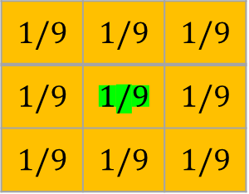
 | 0 | 1 | 2 | 3 | 4 | 5 | 6 | 7 | 8
0 | 80 | 80 | 80 | 25 | 25 | 25 | 87 | 87 | 87
1 | 80 | 80 | 80 | 25 | 25 | 25 | 87 | 87 | 87
2 | 80 | 80 | 80 | 25 | 25 | 25 | 87 | 87 | 87
3 | 2 | 2 | 2 | 255 | 255 | 255 | 10 | 10 | 10
4 | 2 | 2 | 2 | 255 | 255 | 255 | 10 | 10 | 10
5 | 2 | 2 | 2 | 255 | 255 | 255 | 10 | 10 | 10
6 | 25 | 25 | 25 | 10 | 10 | 10 | 20 | 20 | 20
7 | 25 | 25 | 25 | 10 | 10 | 10 | 20 | 20 | 20
8 | 25 | 25 | 25 | 10 | 10 | 10 | 20 | 20 | 20
Target Image
$$1/9$$ | $$1/9$$ | $$1/9$$
$$1/9$$ | $$1/9$$ | $$1/9$$
$$1/9$$ | $$1/9$$ | $$1/9$$
$$filterSize=2k+1$$

